Slide 1
Firms in Competitive Markets, chapter 14 (Mankiw)
If your local gas station raised its price for gasoline by 20 percent, it would see a large drop in the amount of gasoline it sold. Its customers would quickly switch to buying their gasoline at other gas stations. By contrast, if your local water company raised the price of water by 20 percent, it would see only a small decrease in the amount of water it sold. People might water their lawns less often and buy more water-efficient showerheads, but they would be hard-pressed to reduce water consumption greatly and would be unlikely to find another supplier. The difference between the gasoline market and the water market is obvious: Many firms supply gasoline to the local market, but only one firm supplies water. As you might expect, this difference in market structure shapes the pricing and production decisions of the firms that operate in these markets.

Slide 2
What is a competitive market?
You may recall that a market is competitive if each buyer and seller is small compared to the size of the market and, therefore, has little ability to influence market prices. By contrast, if a firm can influence the market price of the good it sells, it is said to have market power. Later in the book, we examine the behavior of firms with market power, such as your local water company.
Our analysis of competitive firms in this chapter sheds light on the decisions that lie behind the supply curve in a competitive market. Not surprisingly, we will find that a market supply curve is tightly linked to firms’ costs of production. Less obvious, however, is the question of which among a firm’s many types of cost— fixed, variable, average, and marginal—are most relevant for its supply decisions. We will see that all these measures of cost play important and interrelated roles.

Slide 3
What is a competitive market?
A competitive market, sometimes called a perfectly competitive market, has two characteristics:
• There are many buyers and many sellers in the market.
• The goods offered by the various sellers are largely the same
Firms can enter or leave the industry whenever they want to. (no entry and/or barrier to exist)
competitive market is a market with many buyers and sellers trading identical products so that each buyer and seller is a price taker

Slide 4
Meaning of price takers?
As a result of these conditions, the actions of any single buyer or seller in the market have a negligible impact on the market price. Each buyer and seller takes the market price as given. As an example, consider the market for milk. No single consumer of milk can influence the price of milk because each buyer purchases a small amount relative to the size of the market. Similarly, each dairy farmer has limited control over the price because many other sellers are offering milk that is essentially identical. Because each seller can sell all he wants at the going price, he has little reason to charge less, and if he charges more, buyers will go elsewhere. Buyers and sellers in competitive markets must accept the price the market determines and, therefore, are said to be price takers.

Slide 5
Perfect Markets
there is a third condition sometimes thought to characterize perfectly competitive markets:
• Firms can freely enter or exit the market.
If, for instance, anyone can decide to start a dairy farm, and if any existing dairy farmer can decide to leave the dairy business, then the dairy industry would satisfy this condition. Much of the analysis of competitive firms does not need the assumption of free entry and exit because this condition is not necessary for firms to be price takers. Yet, as we will see later in this chapter, if there is free entry and exit in a competitive market, it is a powerful force shaping the long-run equilibrium.

Slide 6
Perfect Competition Markets have the following characteristics
There are many buyers and sellers.
Firms face no barrier to entry and/or exit
Firms are price-takers
Firms can make loss or profit in the short run but will only make normal profit in the long run.

Slide 7
Revenue of a competitive firm (perfect competition)
A firm in a competitive market, like most other firms in the economy, tries to maximize profit (total revenue minus total cost). To see how it does this, we first consider the revenue of a competitive firm. To keep matters concrete, let’s consider a specific firm: the Vaca Family Dairy Farm.
The Vaca Farm produces a quantity of milk, Q, and sells each unit at the market price, P. The farm’s total revenue is P × Q. For example, if a gallon of milk sells for $6 and the farm sells 1,000 gallons, its total revenue is $6,000.
Because the Vaca Farm is small compared to the world market for milk, it takes the price as given by market conditions. This means, in particular, that the price of milk does not depend on the number of gallons that the Vaca Farm produces and sells. If the Vacas double the amount of milk they produce to 2,000 gallons, the price of milk remains the same, and their total revenue doubles to $12,000. As a result, total revenue is proportional to the amount of output.

Slide 8
Relationship with cost and revenue functions:
To see what these concepts tell us, consider these two questions:
• How much revenue does the farm receive for the typical gallon of milk?
• How much additional revenue does the farm receive if it increases production of milk by 1 gallon?

Slide 9
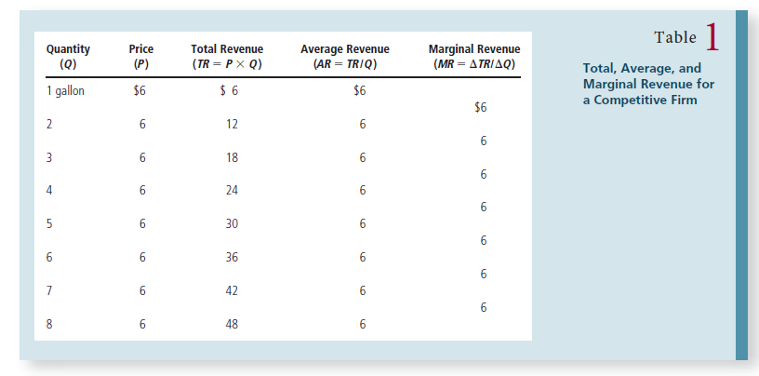

Slide 10
Average Revenue
Average revenue tells us how much revenue a firm receives for the typical unit sold. In Table 1, you can see that average revenue equals $6, the price of a gallon of milk. This illustrates a general lesson that applies not only to competitive firms but to other firms as well. Average revenue is total revenue (P × Q) divided by the quantity (Q). Therefore, for all firms, average revenue equals the price of the good.
The fifth column shows marginal revenue, which is the change in total revenue from the sale of each additional unit of output. In Table 1, marginal revenue equals $6, the price of a gallon of milk. This result illustrates a lesson that applies only to competitive firms. Total revenue is P × Q, and P is fixed for a competitive firm. Therefore, when Q rises by 1 unit, total revenue rises by P dollars. For competitive firms, marginal revenue equals the price of the good.

Slide 11
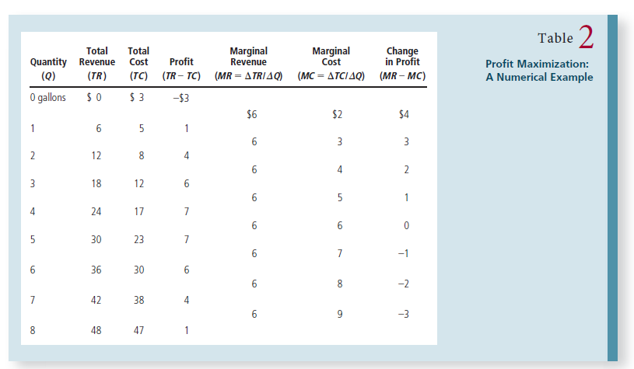

Slide 12
Profit Maximization (MC = MR ) refer to table 2
Total cost includes fixed costs, which are $3 in this example, and variable costs, which depend on the quantity produced. The fourth column shows the farm’s profit, which is computed by subtracting total cost from total revenue.
If the farm produces nothing, it has a loss of $3 (its fixed cost). If it produces 1 gallon, it has a profit of $1. If it produces 2 gallons, it has a profit of $4 and so on. Because the Vaca family’s goal is to maximize profit, it chooses to produce the quantity of milk that makes profit as large as possible. In this example, profit is maximized when the farm produces either 4 or 5 gallons of milk, for a profit of $7.

Slide 13
Till when should the firms produce? MR=MC? MR<MC? or MR>MC?
The Vacas can find the profit-maximizing quantity by comparing the marginal revenue and marginal cost from each unit produced. The fifth and sixth columns in Table 2 compute marginal revenue and marginal cost from the changes in total revenue and total cost, and the last column shows the change in profit for each additional gallon produced. The first gallon of milk the farm produces has a marginal revenue of $6 and a marginal cost of $2; hence, producing that gallon increases profit by $4 (from –$3 to $1). The second gallon produced has a marginal revenue of $6 and a marginal cost of $3, so that gallon increases profit by $3 (from $1 to $4). As long as marginal revenue exceeds marginal cost, increasing the quantity produced raises profit. Once the Vaca Farm has reached 5 gallons of milk, however, the situation changes. The sixth gallon would have a marginal revenue of $6 and a marginal cost of $7, so producing it would reduce profit by $1 (from $7 to $6). As a result, the Vacas would not produce beyond 5 gallons.

Slide 14
that rational people think at the margin. We now see how the Vaca Family Dairy Farm can apply this principle. If marginal revenue is greater than marginal cost—as it is at 1, 2, or 3 gallons—the Vacas should increase the production of milk because it will put more money in their pockets (marginal revenue) than it takes out (marginal cost).
If marginal revenue is less than marginal cost—as it is at 6, 7, or 8 gallons—the Vacas should decrease production. If the Vacas think at the margin and make incremental adjustments to the level of production, they are naturally led to produce the profit-maximizing quantity.

Slide 15
Putting it all together
The marginal-cost curve (MC) is upward sloping. The average-total-cost curve (ATC) is U-shaped. And the marginal-cost curve crosses the average-total-cost curve at the minimum of average total cost. The figure also shows a horizontal line at the market price (P). The price line is horizontal because the firm is a price taker: The price of the firm’s output is the same regardless of the quantity that the firm decides to produce. Keep in mind that, for a competitive firm, the firm’s price equals both its average revenue (AR) and its marginal revenue (MR).

Slide 16
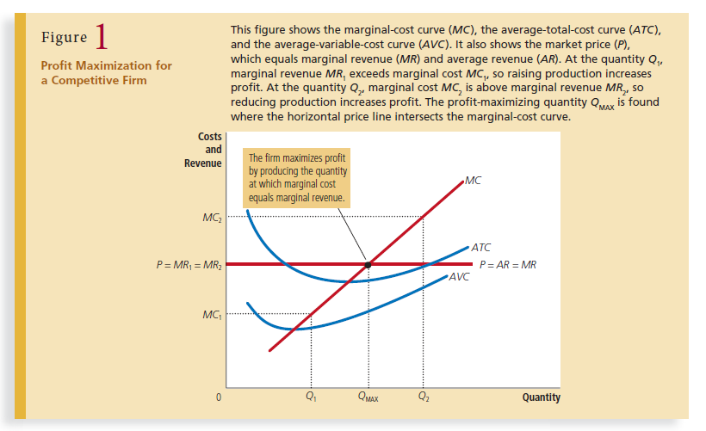

Slide 17
The analysis:
This analysis yields three general rules for profit maximization:
• If marginal revenue is greater than marginal cost, the firm should increase its output.
• If marginal cost is greater than marginal revenue, the firm should decrease its output.
• At the profit-maximizing level of output, marginal revenue and marginal cost are exactly equal.

Slide 18
The competitive firm’s supply curve
We can now see how the competitive firm decides the quantity of its good to supply to the market. Because a competitive firm is a price taker, its marginal revenue equals the market price. For any given price, the competitive firm’s profit-maximizing quantity of output is found by looking at the intersection of the price with the marginal-cost curve.
In essence, because the firm’s marginal-cost curve determines the quantity of the good the firm is willing to supply at any price, the marginal-cost curve is also the competitive firm’s supply curve. There are, however, some caveats to that conclusion,

Slide 19
The Firm’s Short-Run Decision to Shut Down
Here we need to distinguish between a temporary shutdown of a firm and the permanent exit of a firm from the market. A shutdown refers to a short-run decision not to produce anything during a specific period of time because of current market conditions. Exit refers to a long-run decision to leave the market. The short-run and long-run decisions differ because most firms cannot avoid their fixed costs in the short run but can do so in the long run. That is, a firm that shuts down temporarily still has to pay its fixed costs, whereas a firm that exits the market does not have to pay any costs at all, fixed or variable.

Slide 20
The firm’s short run decision to shut down
For example, consider the production decision that a farmer faces. The cost of the land is one of the farmer’s fixed costs. If the farmer decides not to produce any crops one season, the land lies fallow, and he cannot recover this cost. When making the short-run decision whether to shut down for a season, the fixed cost of land is said to be a sunk cost. By contrast, if the farmer decides to leave farming altogether, he can sell the land. When making the long-run decision whether to exit the market, the cost of land is not sunk.

Slide 21
The firm’s short run decision to shut down
Now let’s consider what determines a firm’s shutdown decision. If the firm shuts down, it loses all revenue from the sale of its product. At the same time, it saves the variable costs of making its product (but must still pay the fixed costs). Thus, the firm shuts down if the revenue that it would earn from producing is less than its variable costs of production. A bit of mathematics can make this shutdown criterion more useful. If TR stands for total revenue and VC stands for variable costs, then the firm’s decision can be written as:
TR < VC
The firm shuts down if total revenue is less than variable cost. By dividing both sides of this inequality by the quantity Q, we can write it as:
PxQ/Q < AVC , so if P <AVC, firm will shut down.

Slide 22
The firm’s short run decision to shut down
That is, a firm chooses to shut down if the price of the good is less than the average variable cost of production. This criterion is intuitive: When choosing to produce, the firm compares the price it receives for the typical unit to the average variable cost that it must incur to produce the typical unit. If the price doesn’t cover the average variable cost, the firm is better off stopping production altogether. The firm still loses money (because it has to pay fixed costs), but it would lose even more money by staying open. The firm can reopen in the future if conditions change so that price exceeds average variable cost.

Slide 23
The firm’s short run decision to shut down
We now have a full description of a competitive firm’s profit-maximizing strategy. If the firm produces anything, it produces the quantity at which marginal cost equals the price of the good. Yet if the price is less than average variable cost at that quantity, the firm is better off shutting down and not producing anything. These results are illustrated in Figure 3. The competitive firm’s short-run supply curve is the portion of its marginal-cost curve that lies above average variable cost.

Slide 24
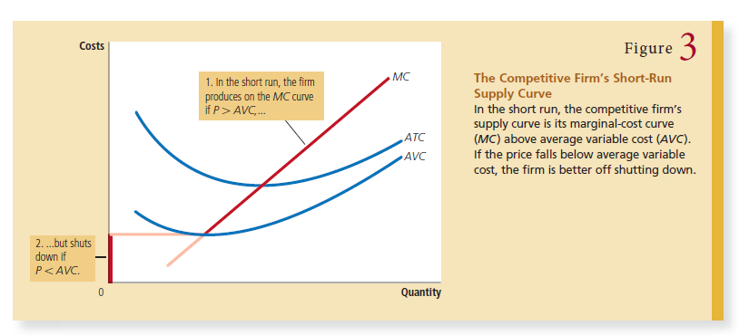

Slide 25
The Firm’s Long-Run Decision to Exit or Enter a Market
A firm’s long-run decision to exit a market is similar to its shutdown decision. If the firm exits, it will again lose all revenue from the sale of its product, but now it will save not only its variable costs of production but also its fixed costs. Thus, the firm exits the market if the revenue it would get from producing is less than its total costs. We can again make this criterion more useful by writing it mathematically. If TR stands for total revenue, and TC stands for total cost, then the firm’s exit criterion can be written as:
TR < TC
The firm exits if total revenue is less than total cost

Slide 26
The Firm’s Long-Run Decision to Exit or Enter a Market
By dividing both sides of this inequality by quantity Q, we can write it as,
TR/Q < TC/Q
We know that TR/Q is AR which is P, and TC/Q is ATC (AC), so shut down if P < AC
That is, a firm chooses to exit if the price of its good is less than the average total
cost of production.

Slide 27
The Firm’s Long-Run Decision to Exit or Enter a Market
A parallel analysis applies to an entrepreneur who is considering starting a firm. The firm will enter the market if such an action would be profitable, which occurs if the price of the good exceeds the average total cost of production. The entry criterion is:
P > ATC
These firms cannot influence price, but they can influence their cost of production, hence would enter if prices being charged is greater than cost of production.

Slide 28
A competitive firm’s long-run profit-maximizing strategy.
We can now describe a competitive firm’s long-run profit-maximizing strategy. If the firm is in the market, it produces the quantity at which marginal cost equals the price of the good. Yet if the price is less than the average total cost at that quantity, the firm chooses to exit (or not enter) the market. These results are illustrated in Figure 4. The competitive firm’s long-run supply curve is the portion of its marginal-cost curve that lies above average total cost.

Slide 29
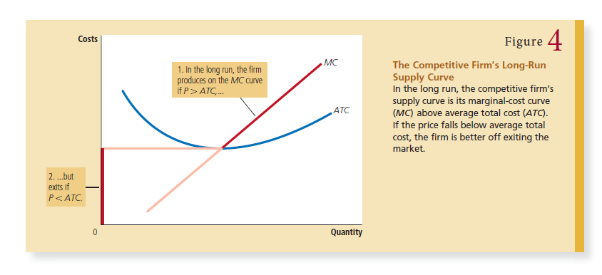

Slide 30
Measuring Profit in Our Graph for the Competitive Firm
As we study exit and entry, it is useful to analyze the firm’s profit in more detail. Recall that profit equals total revenue (TR) minus total cost (TC):
Profit = TR – TC,
Let us re-write this by dividing by Q, so
Profit = (TR/Q – TC/Q) x Q
But note that TR/Q is average revenue, which is the price, P, and TC/Q is average total cost, ATC. Therefore,
Profit = (P-AC)xQ

Slide 31
Measuring Profit/Loss in Our Graph for the Competitive Firm
This way of expressing the firm’s profit allows us to measure profit in our graphs. Panel (a) of Figure 5 shows a firm earning positive profit. As we have already discussed, the firm maximizes profit by producing the quantity at which price equals marginal cost. Now look at the shaded rectangle. The height of the rectangle is P – ATC
the difference between price and average total cost. The width of the rectangle is Q, the quantity produced. Therefore, the area of the rectangle is (P – ATC) × Q, which is the firm’s profit. Similarly, panel (b) of this figure shows a firm with losses (negative profit). In
this case, maximizing profit means minimizing losses, a task accomplished once again by producing the quantity at which price equals marginal cost. Now consider the shaded rectangle. The height of the rectangle is ATC – P, and the width is Q. The area is (ATC – P) × Q, which is the firm’s loss. Because a firm in this situation is not making enough revenue to cover its average total cost, the firm would choose in the long run to exit the market.

Slide 32
